Slide 1
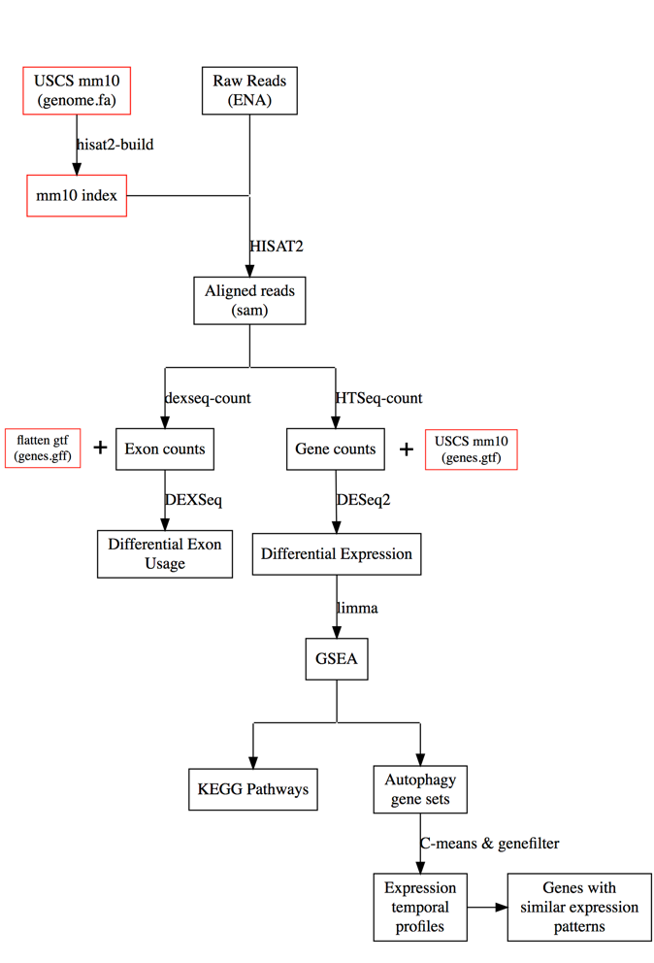
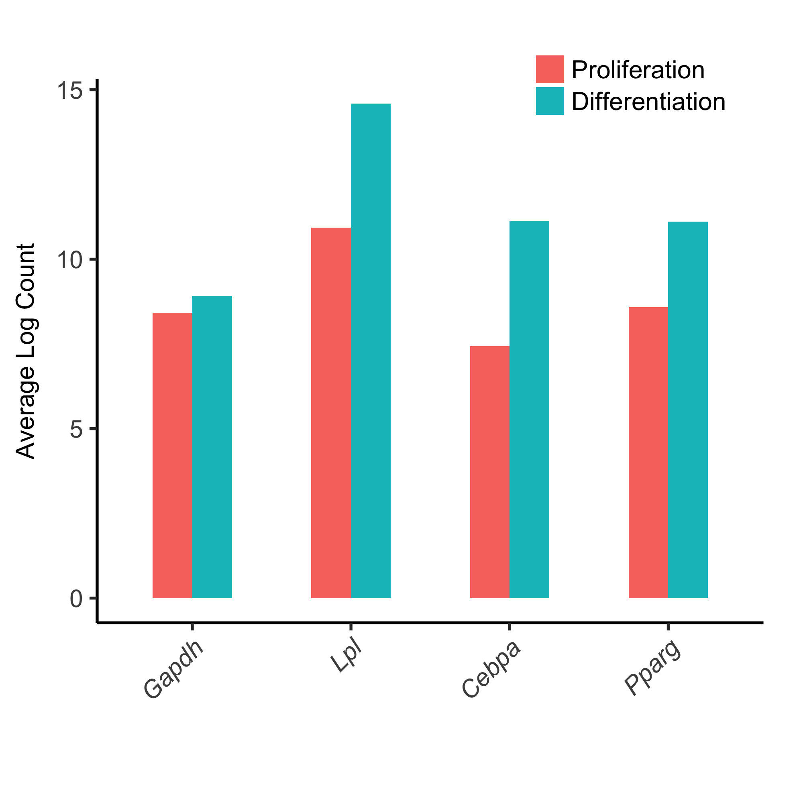
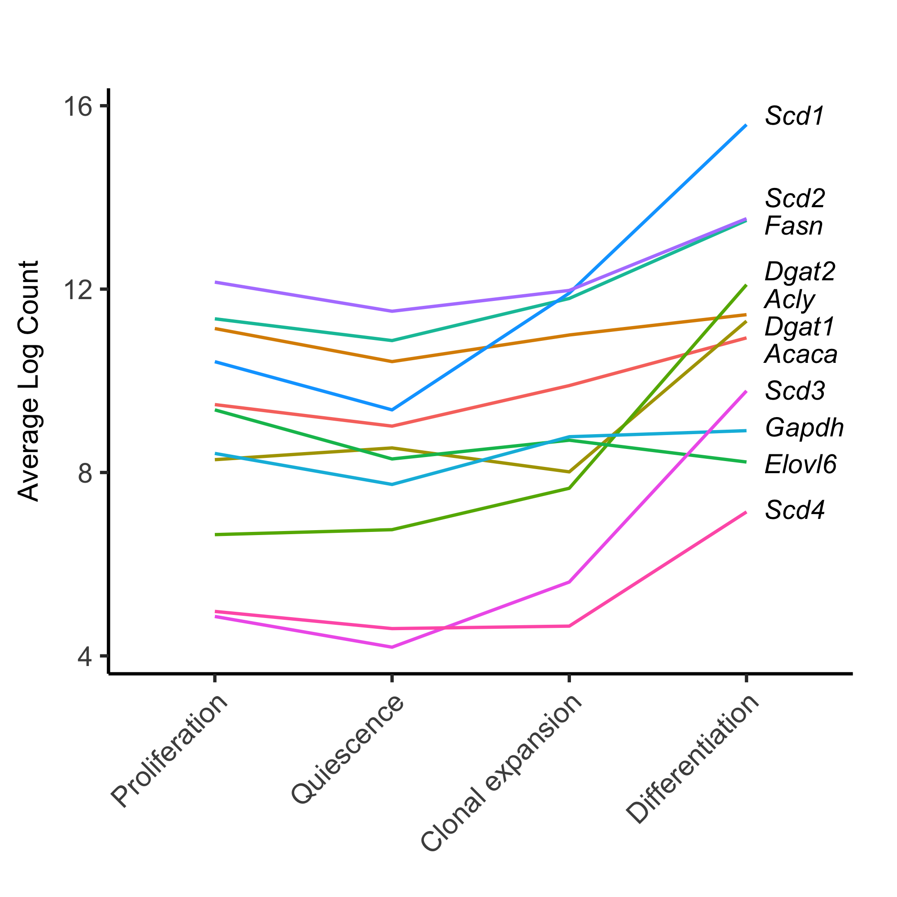
Figure 1
A
B
C

Slide 2
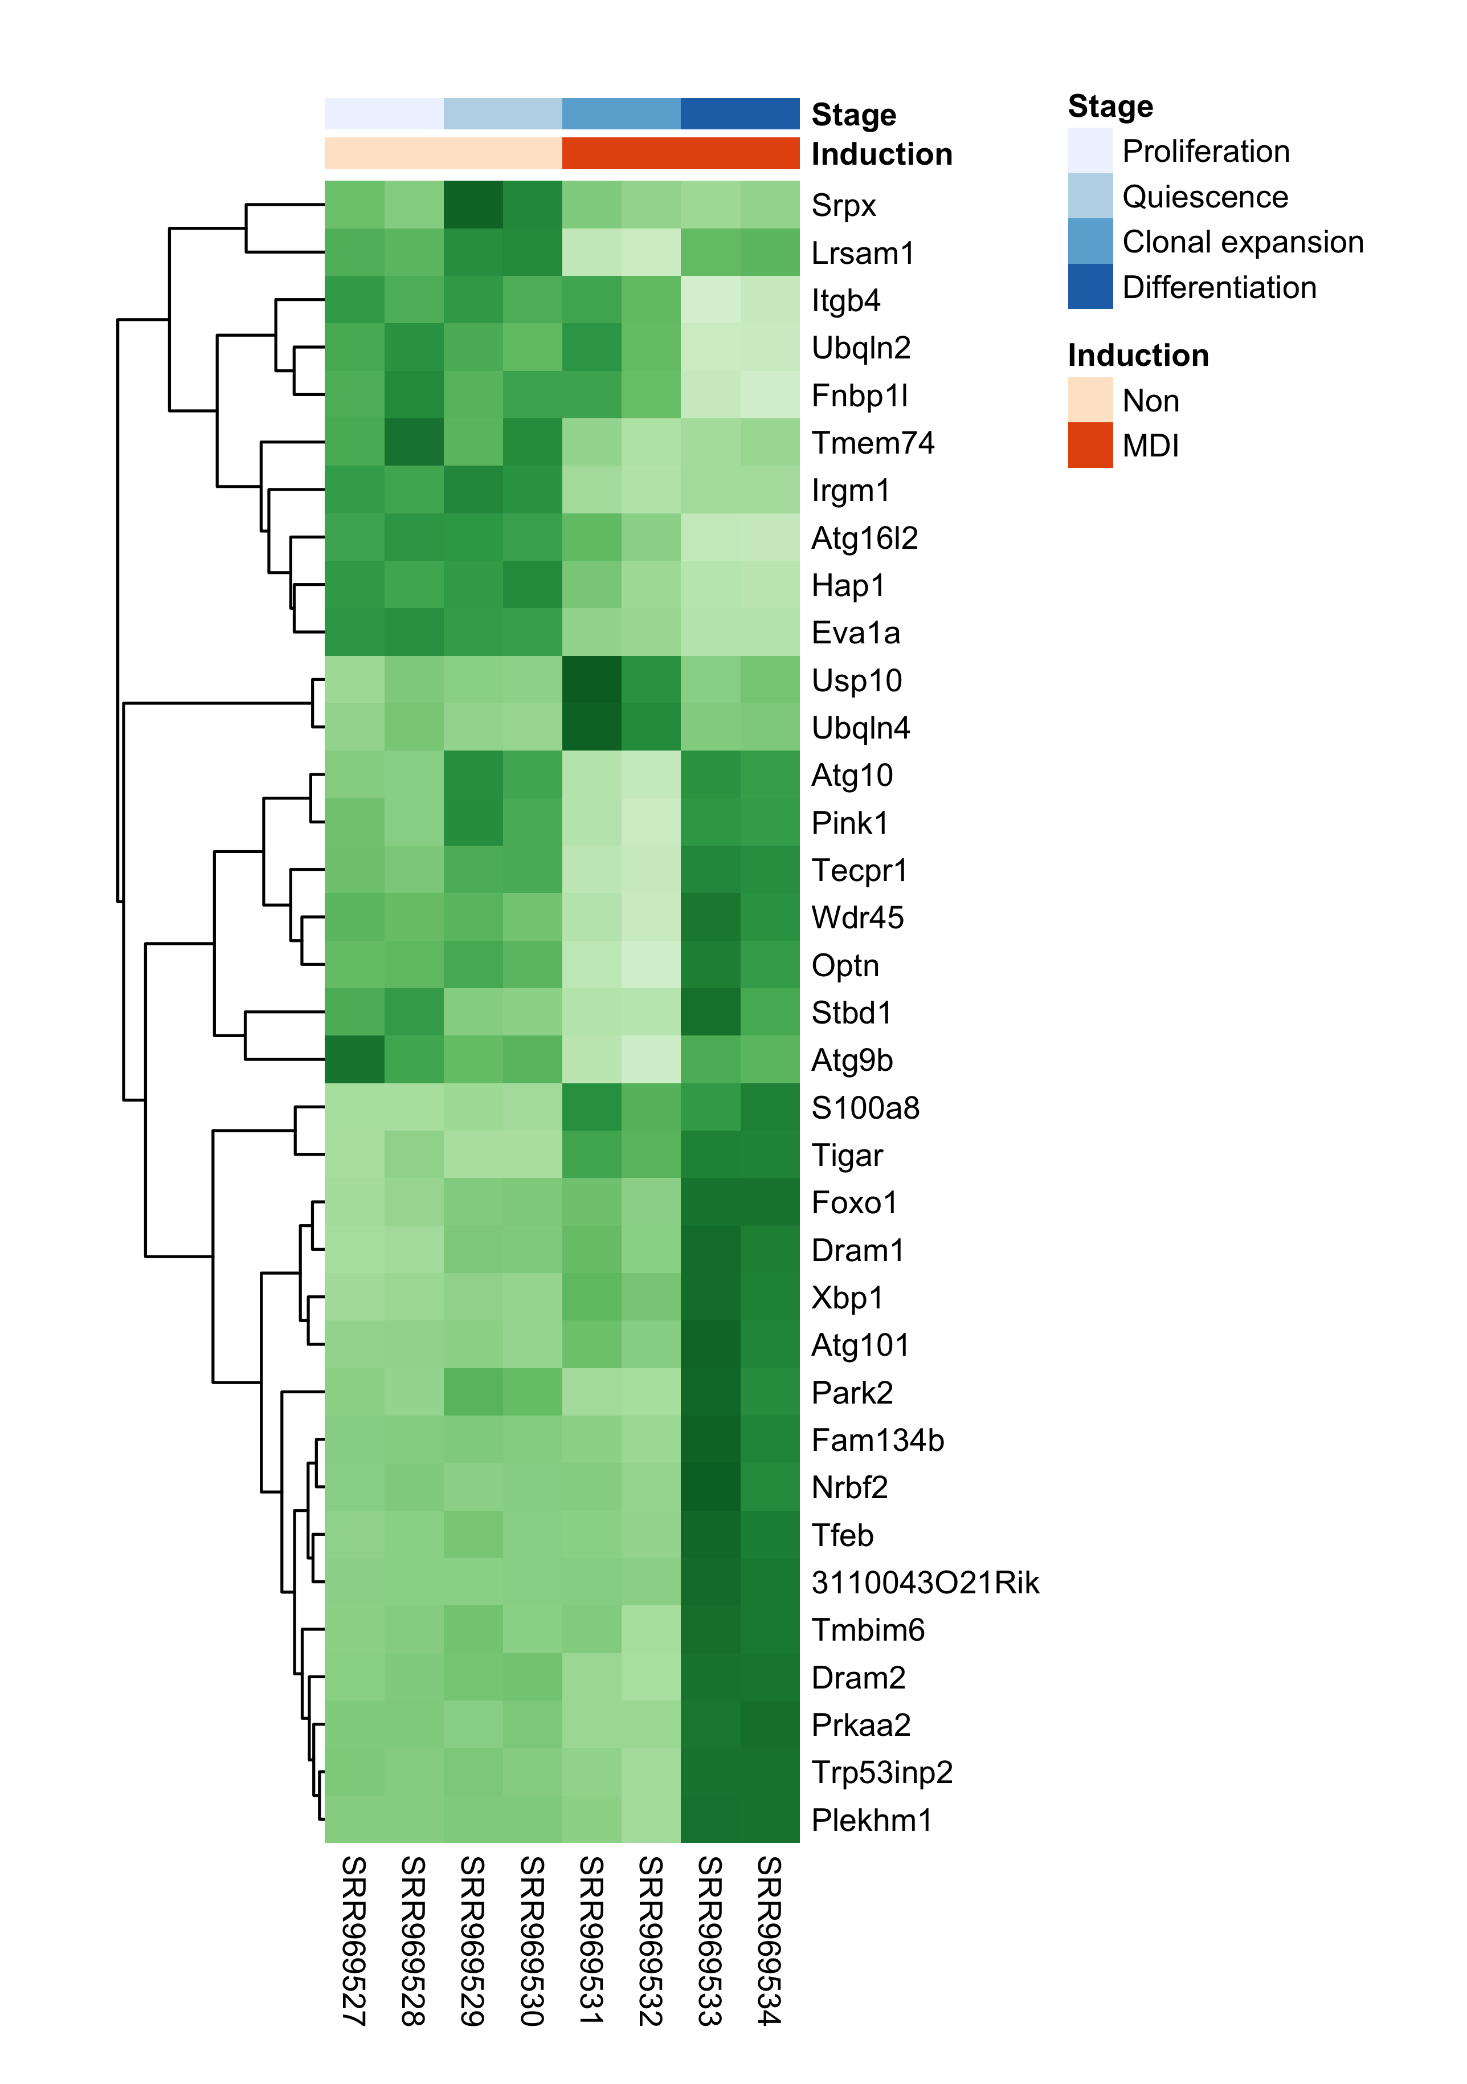
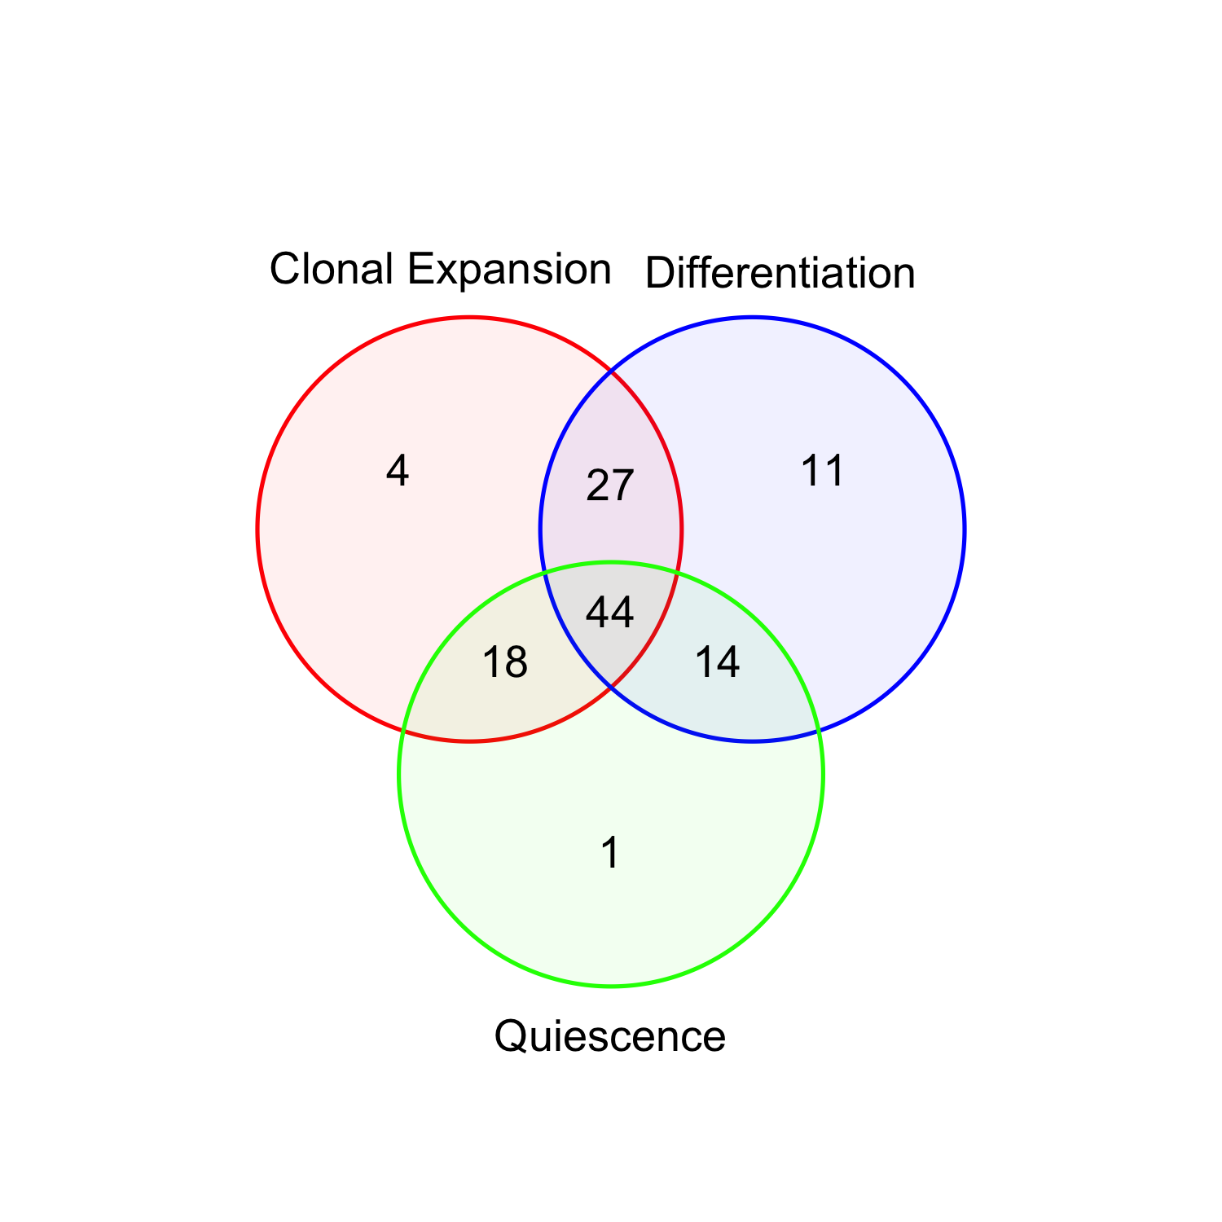
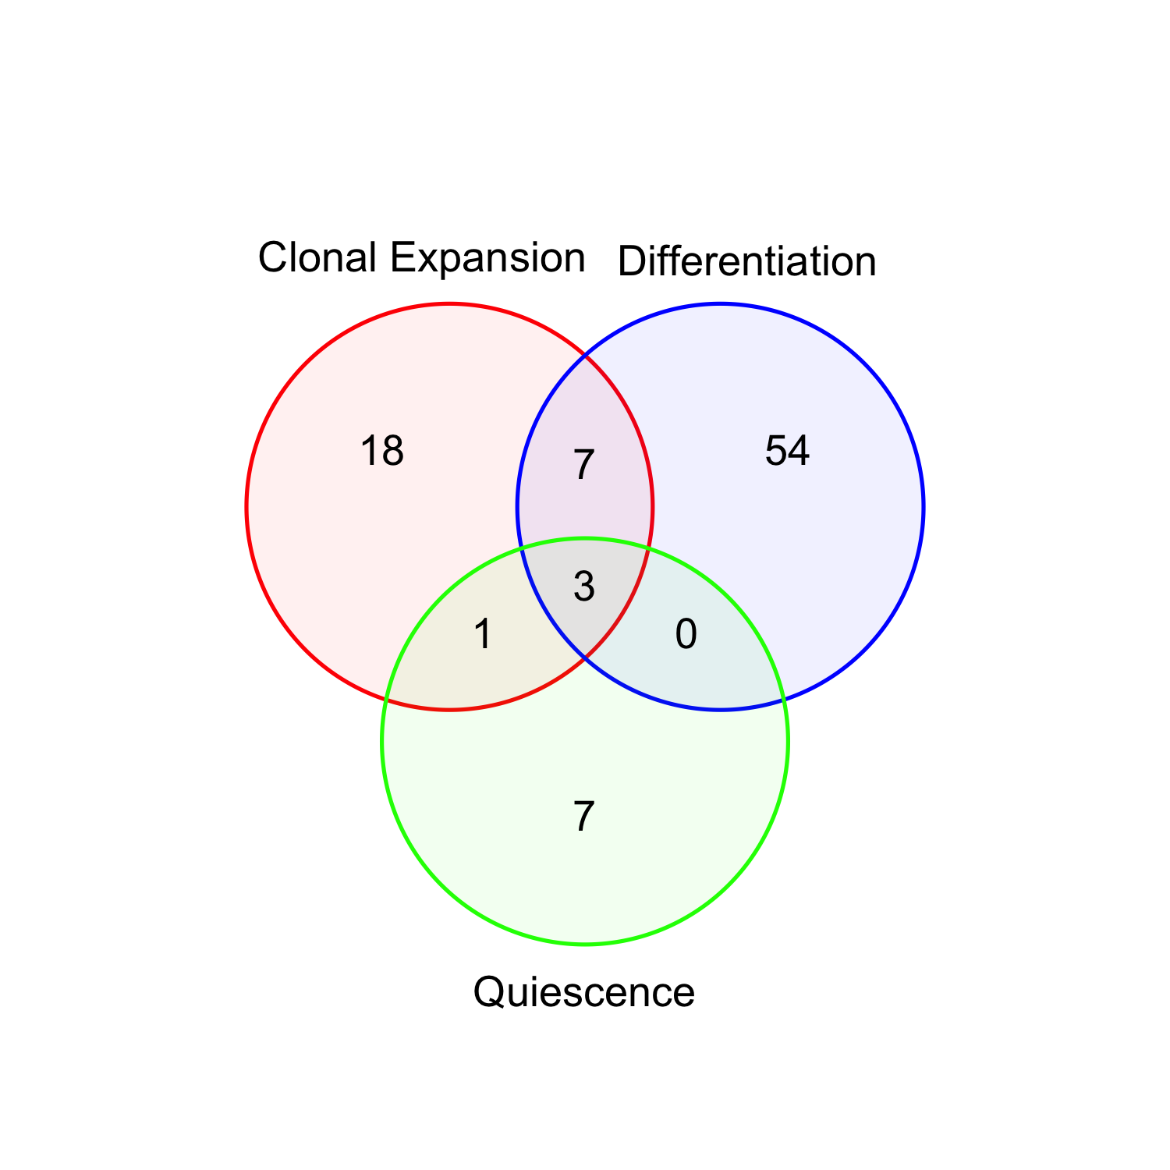
Figure 2
A
C
B

Slide 3
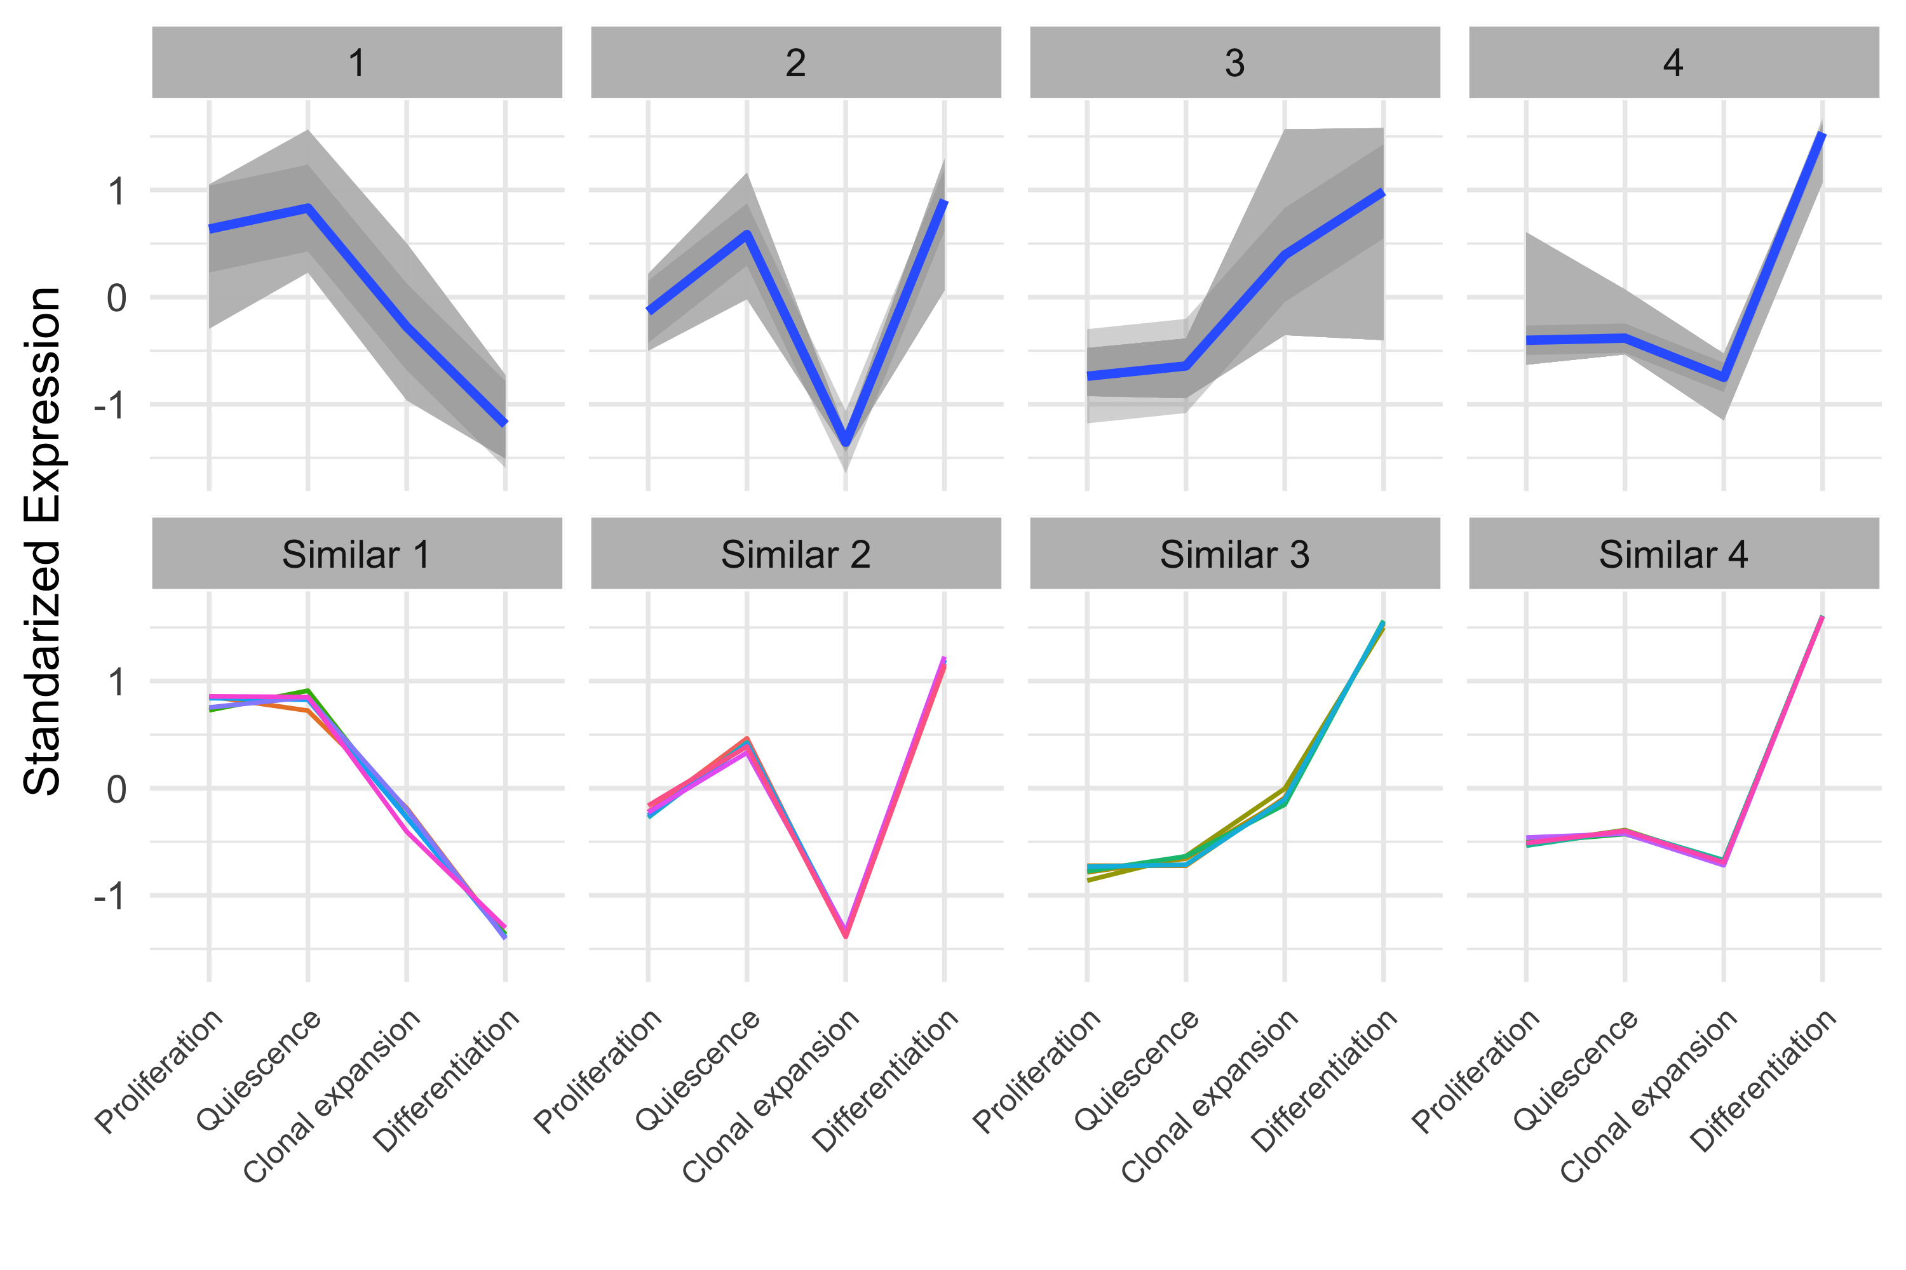
Figure 3

Slide 4
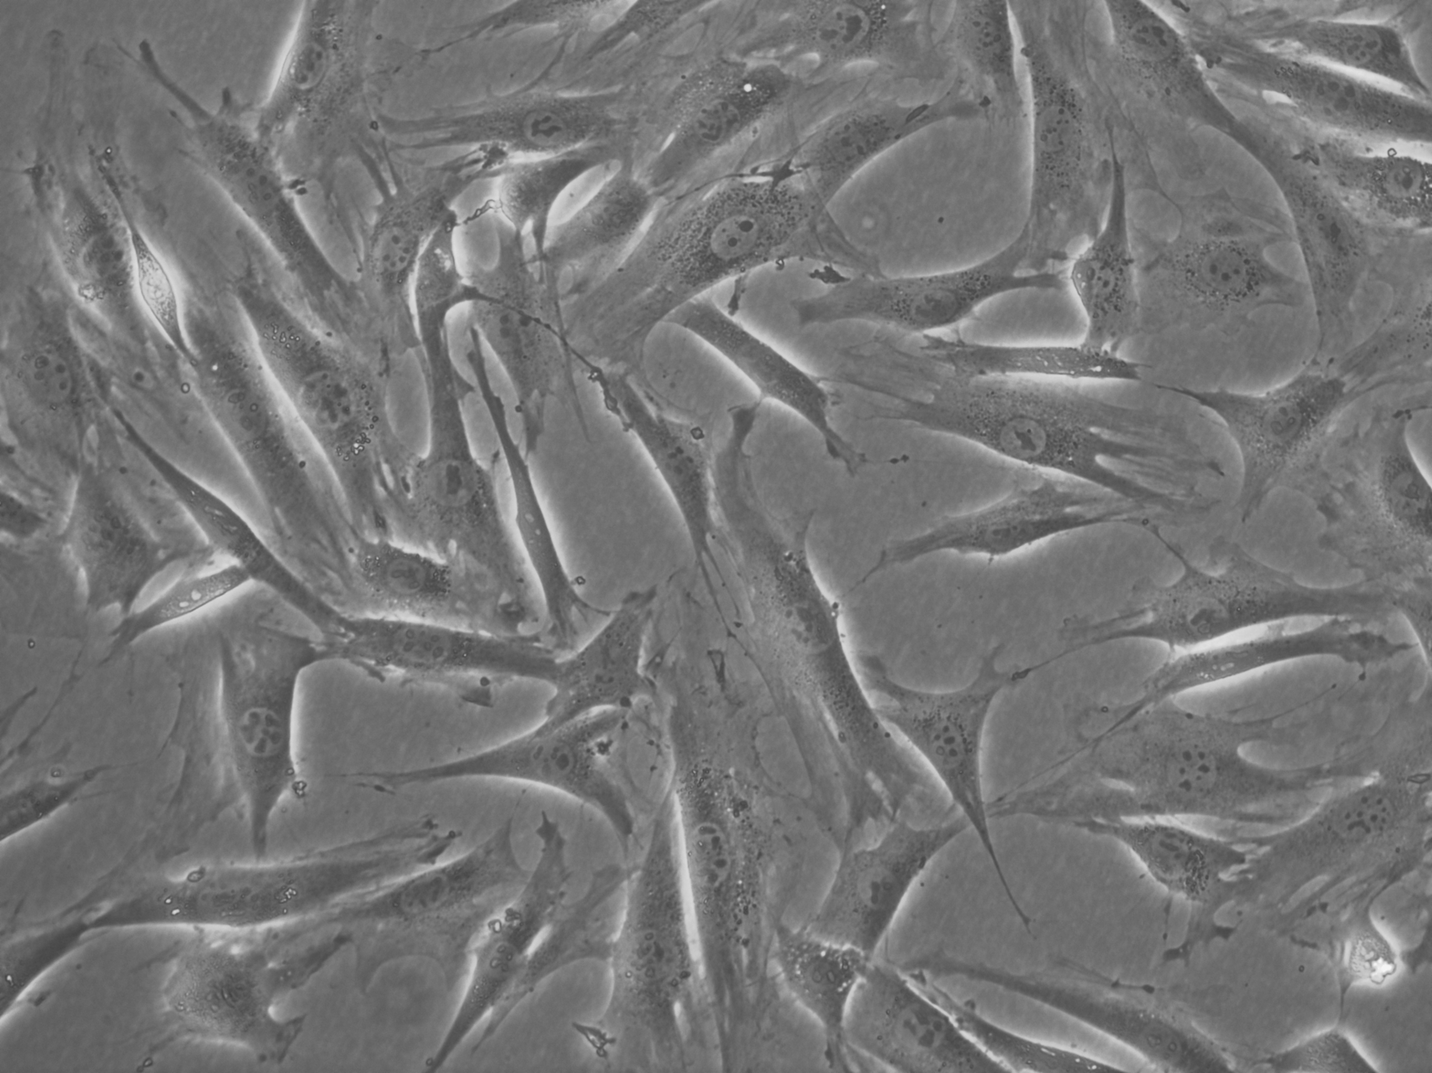
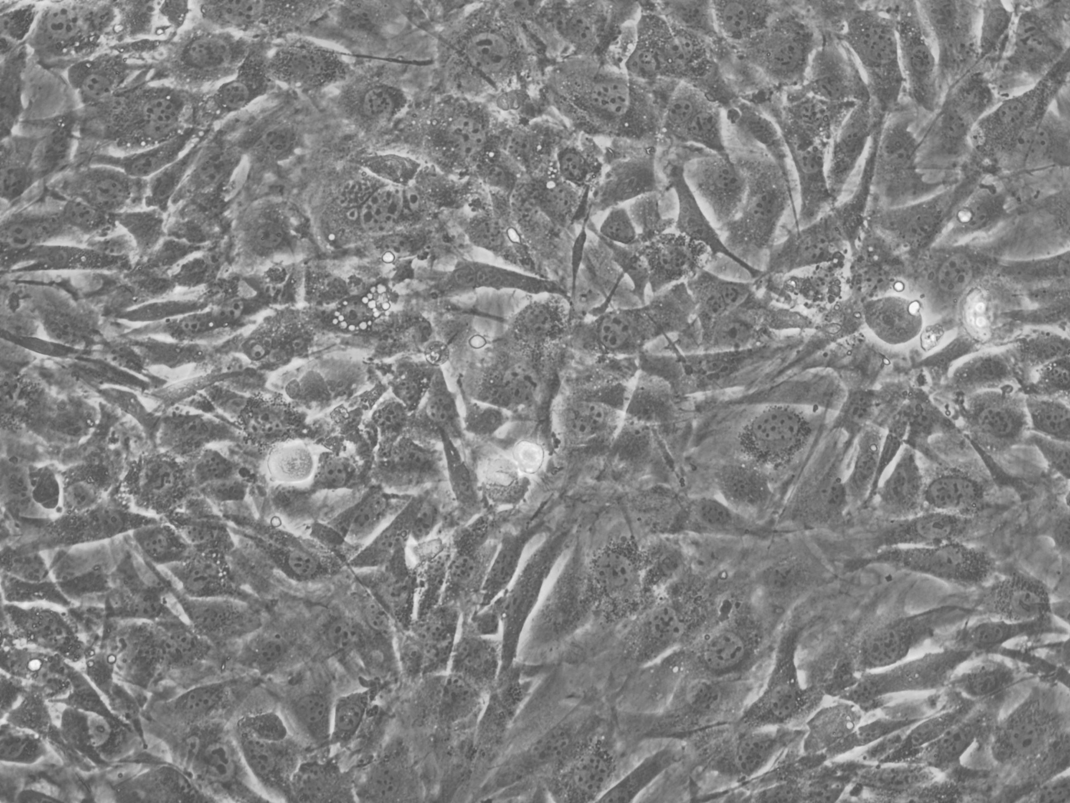
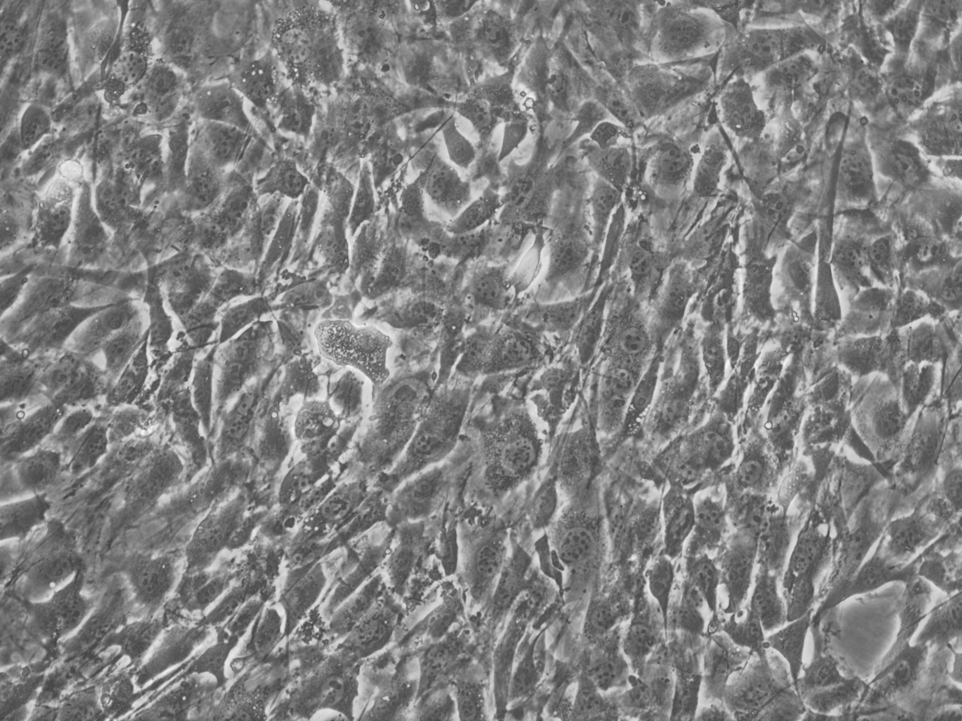
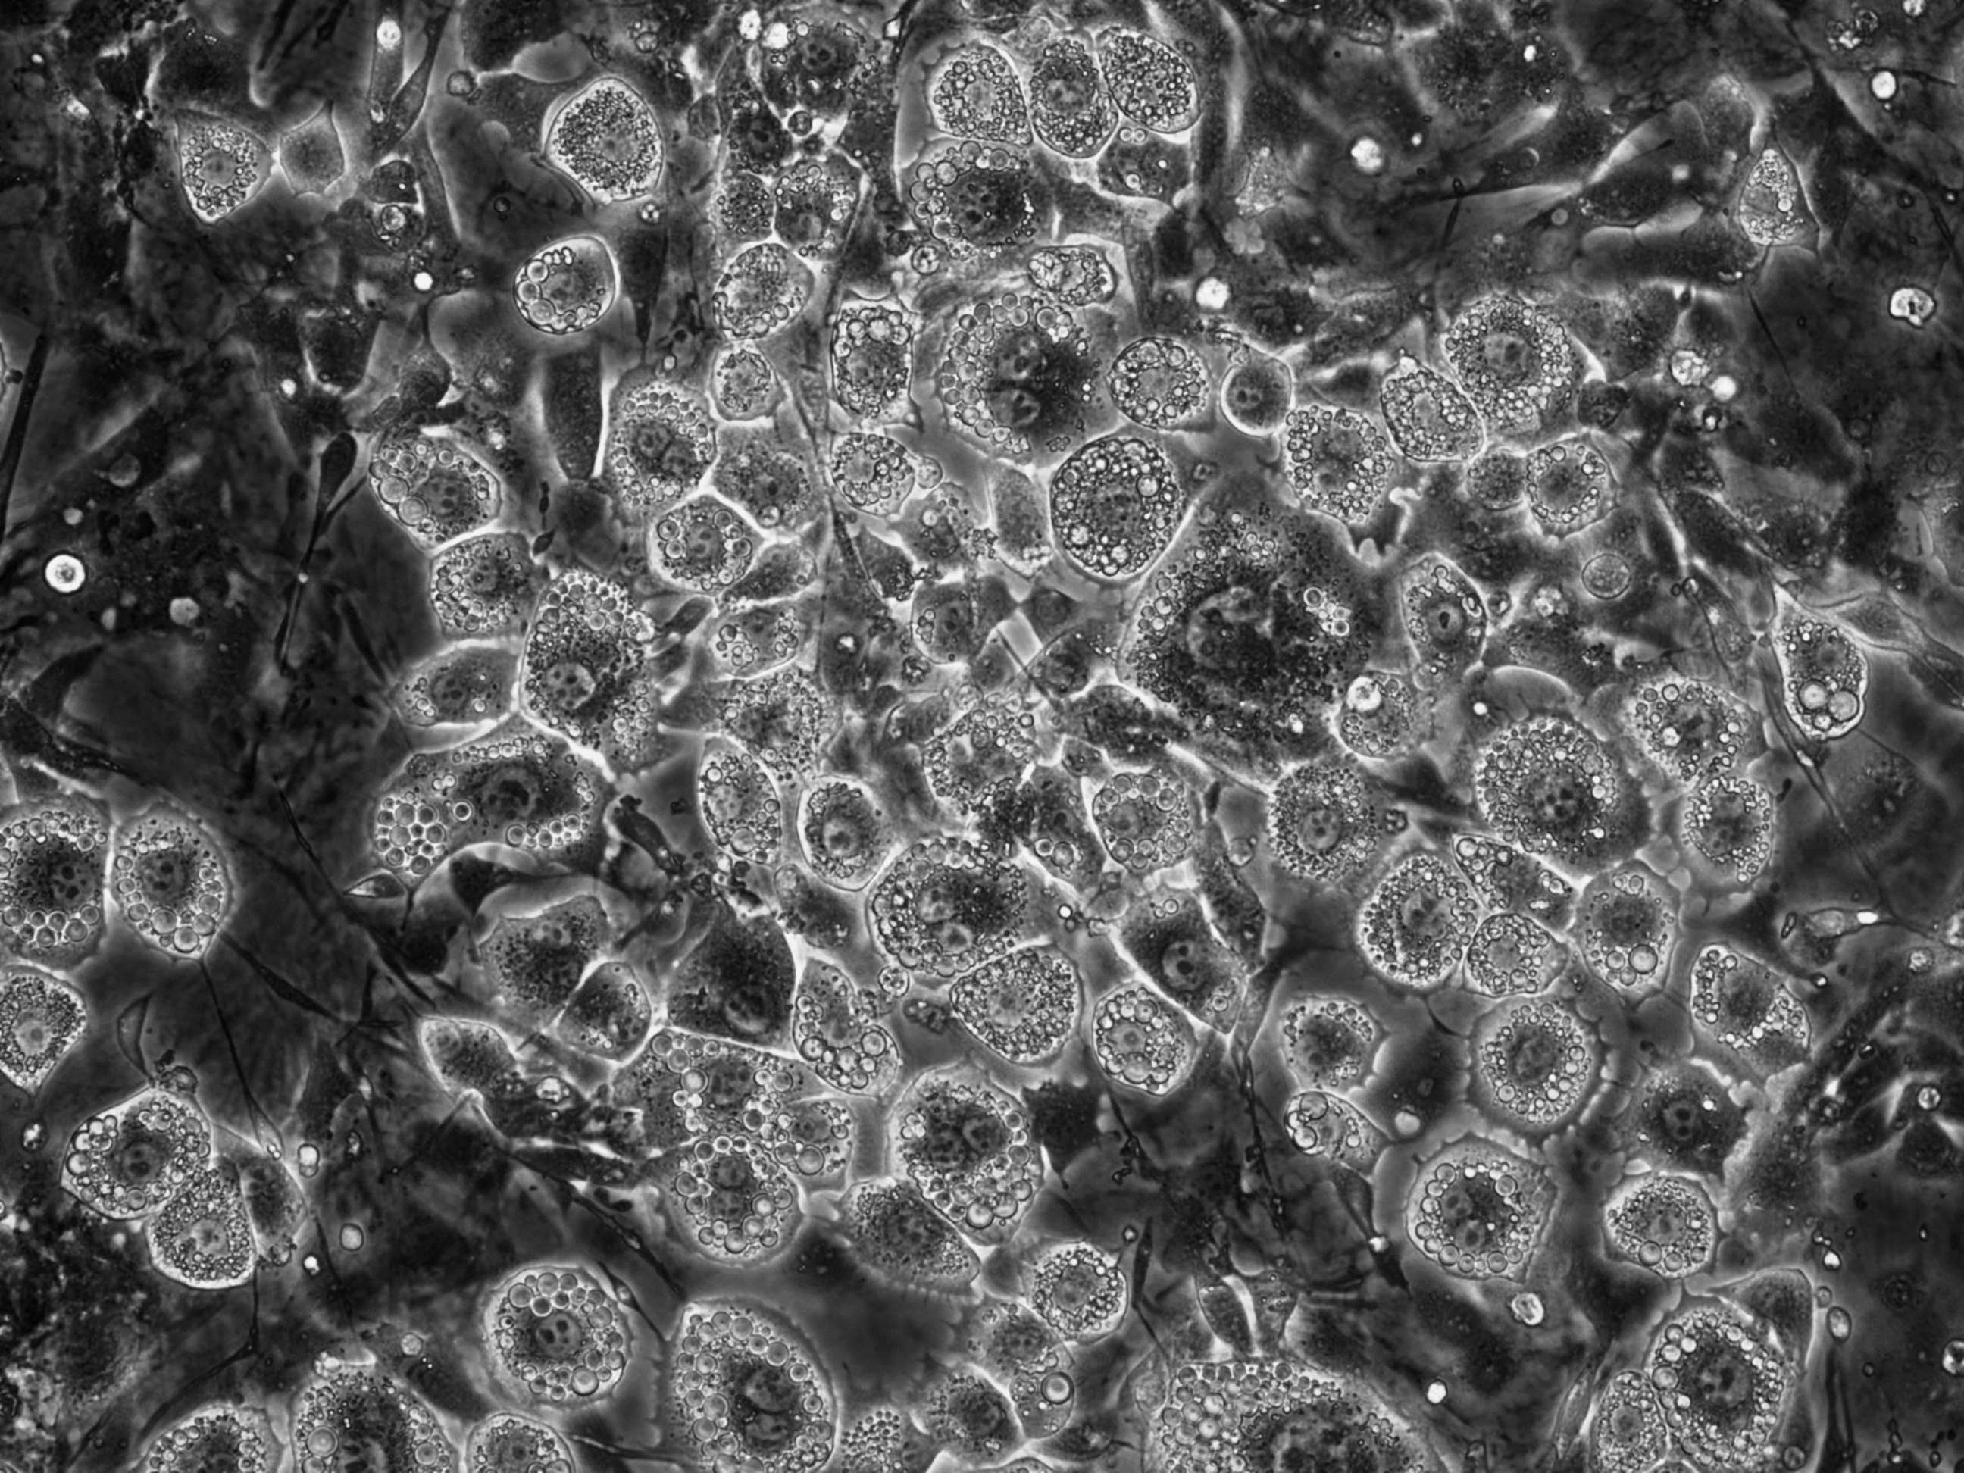
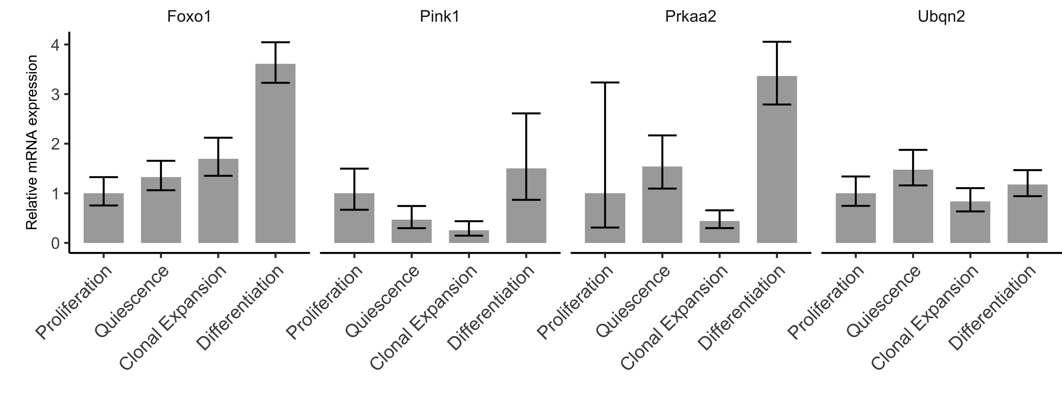
Figure 4
A
Proliferation
Quiescence
Clonal Expansion
Differentiation
B

Slide 5
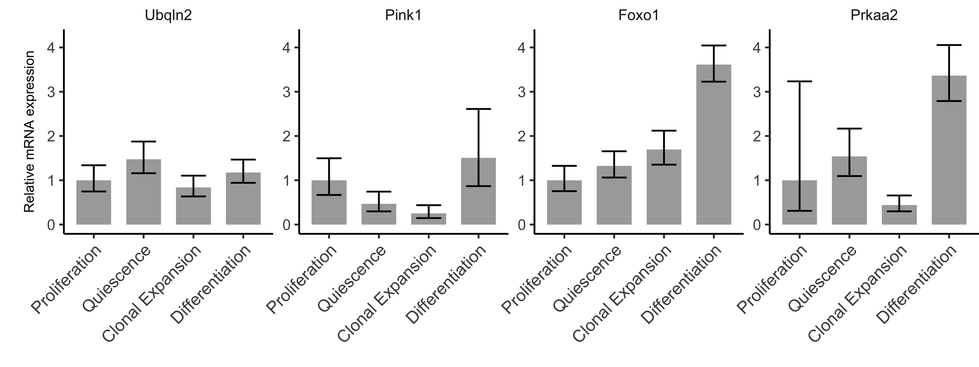
Figure 4
A
Proliferation
Quiescence
Clonal Expansion
Differentiation
B

Slide 6
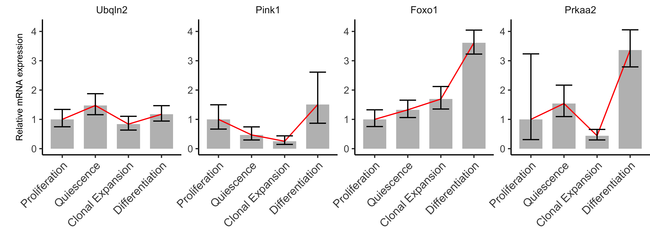
Figure 4
A
Proliferation
Quiescence
Clonal Expansion
Differentiation
B

Slide 7
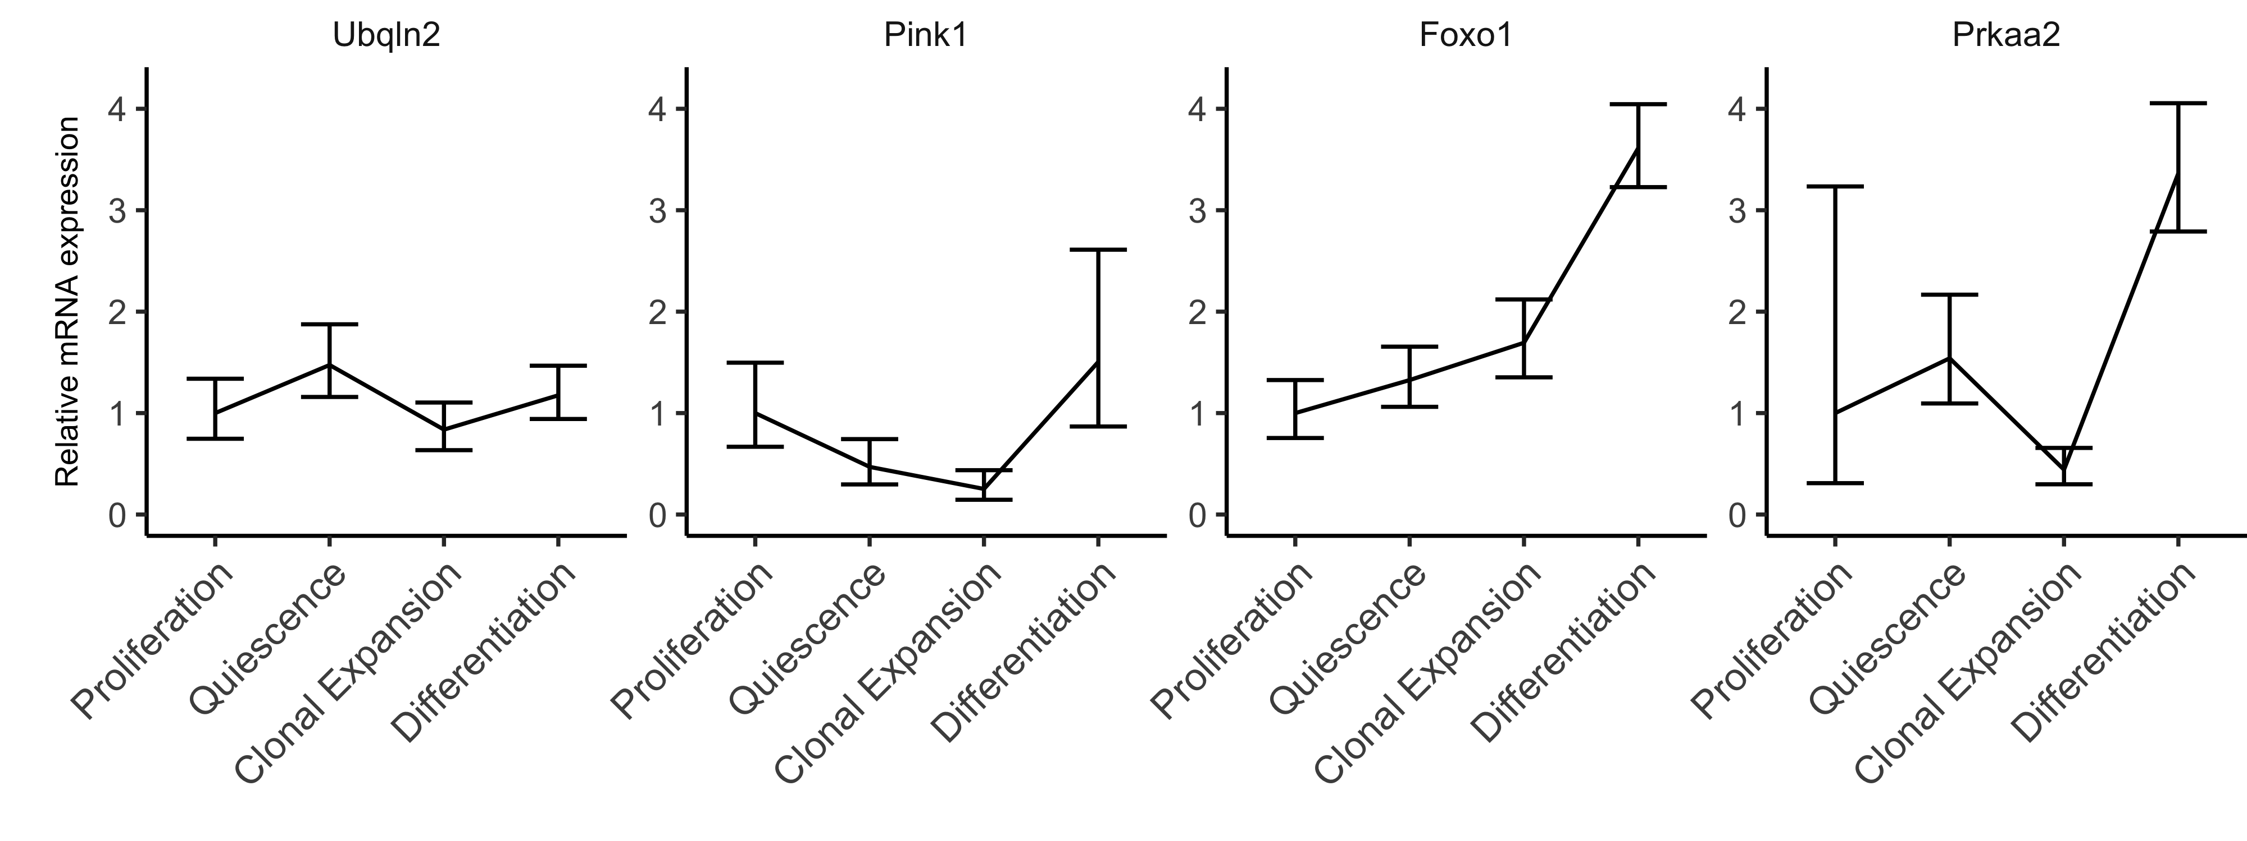
Figure 4
A
Proliferation
Quiescence
Clonal Expansion
Differentiation
B

Slide 8
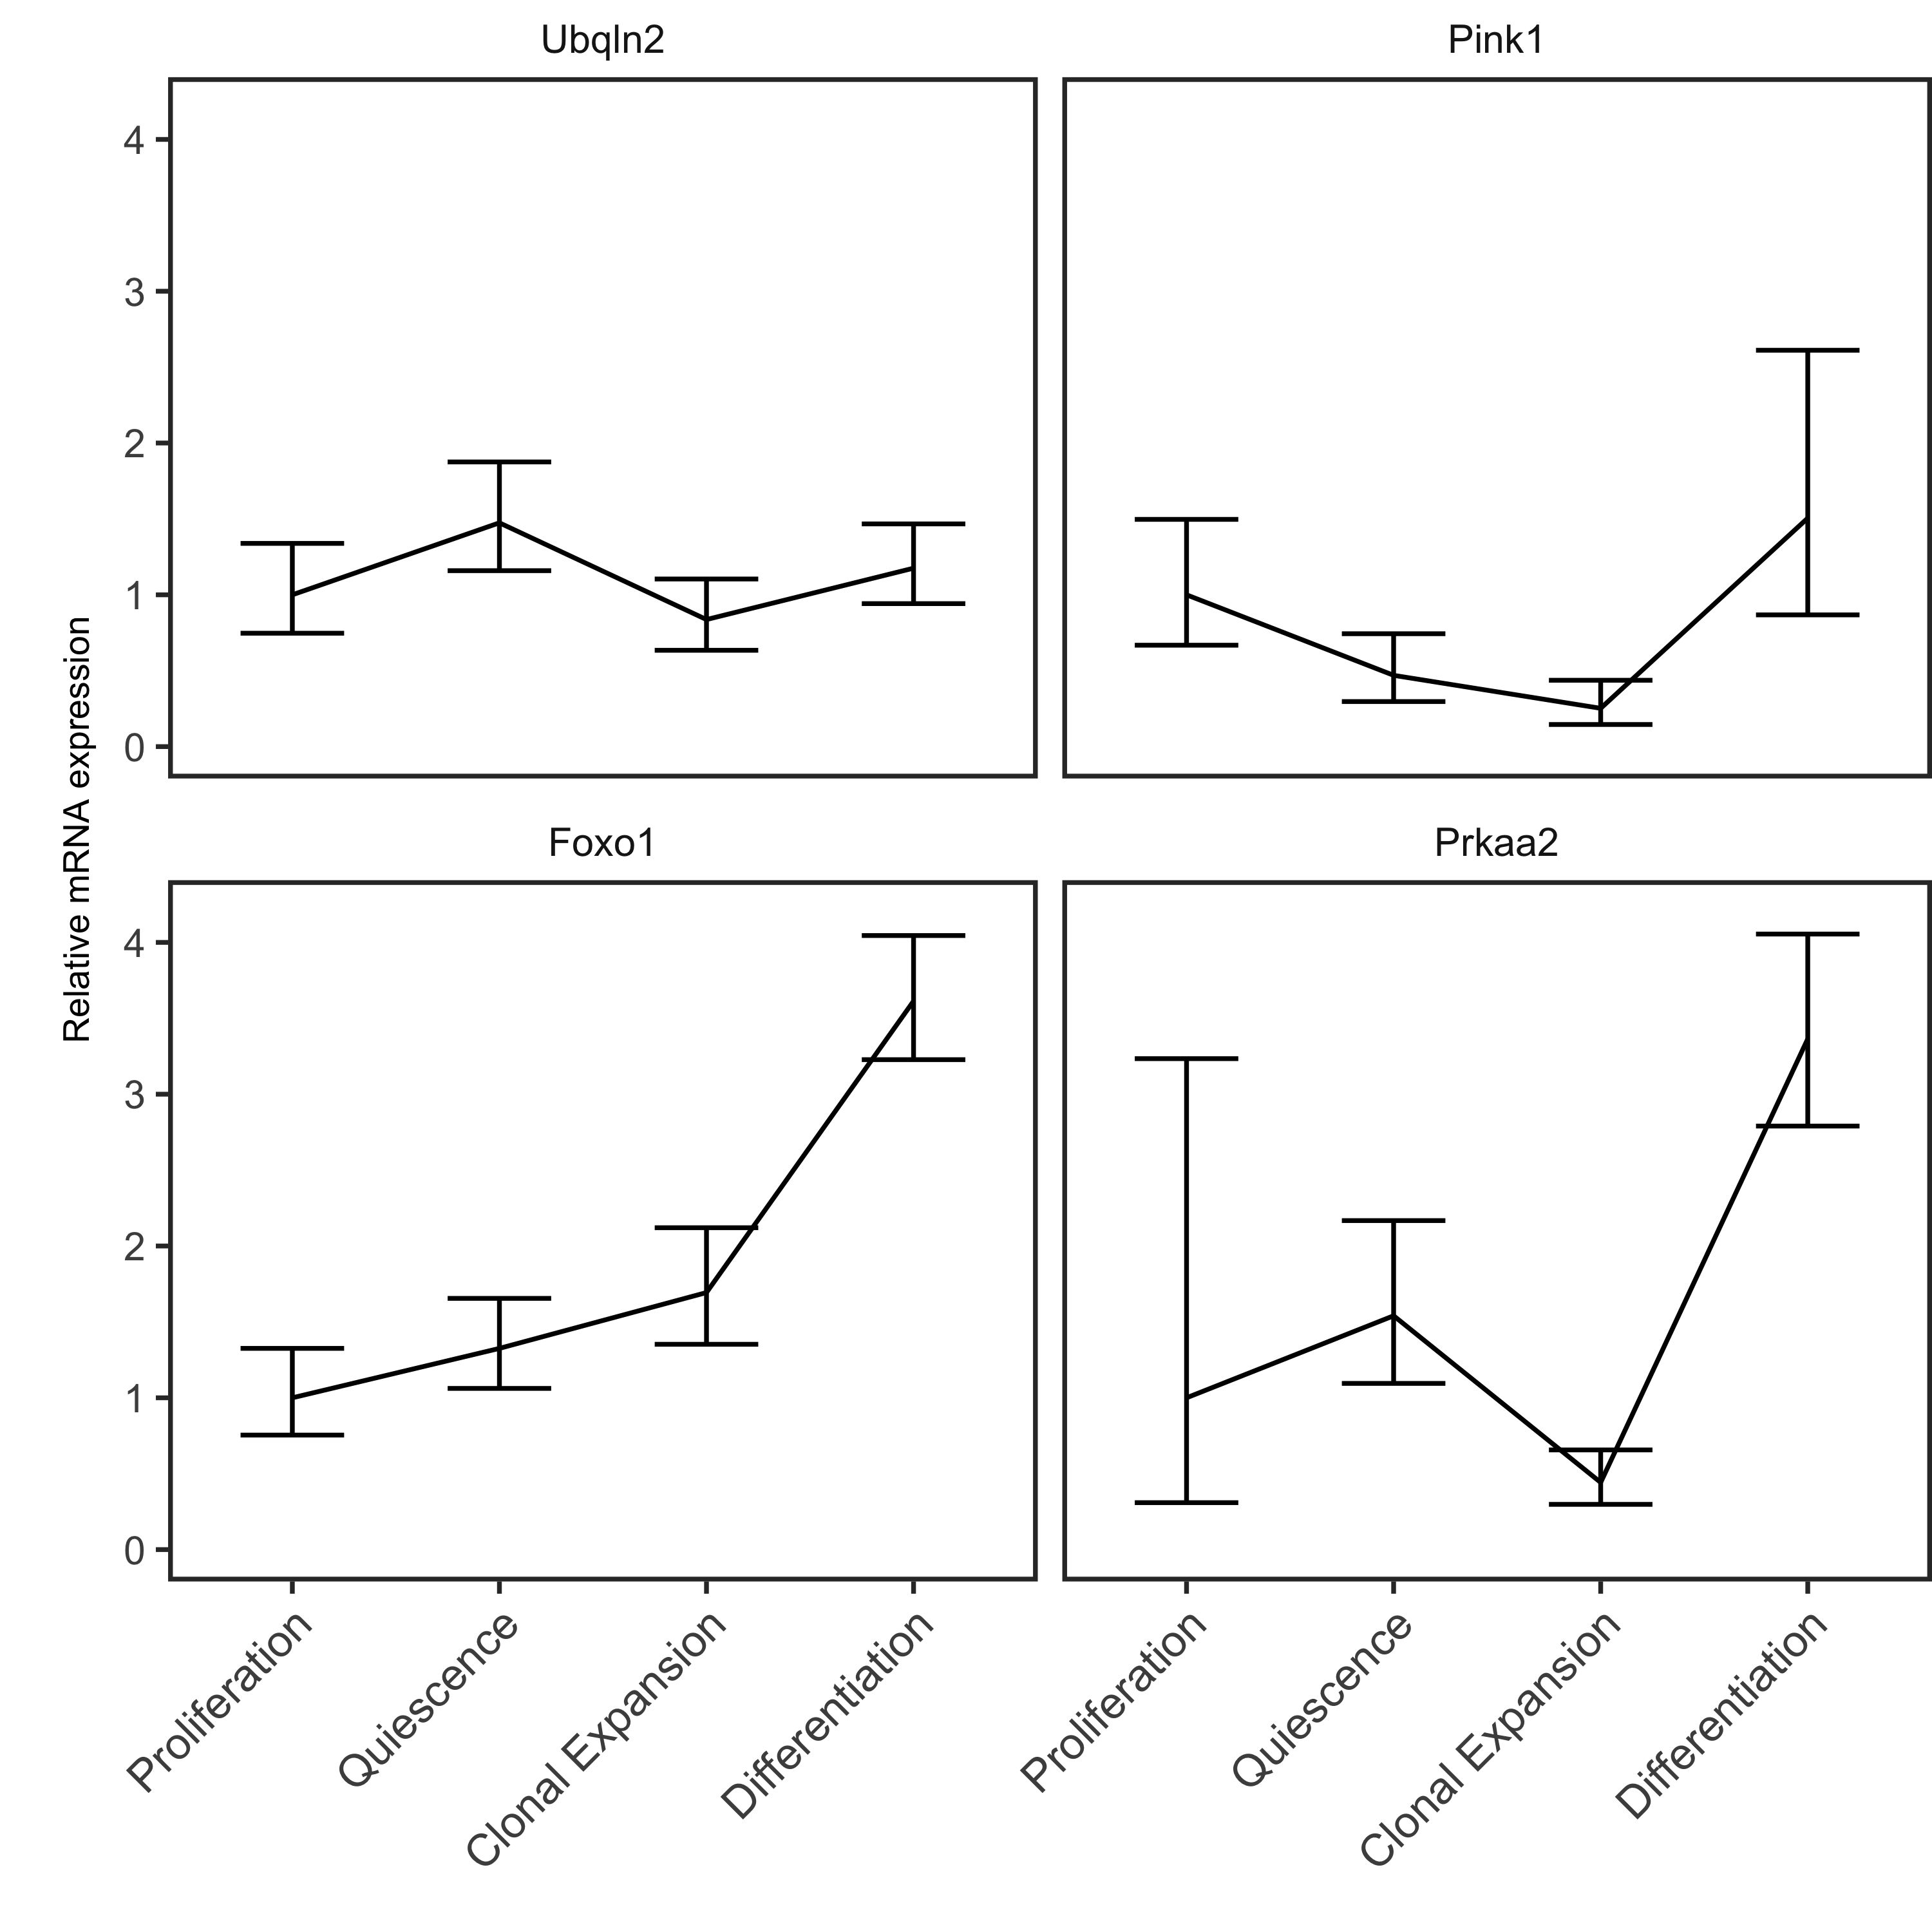
Figure 4
A
B
Proliferation
Quiescence
Clonal Expansion
Differentiation

Slide 9
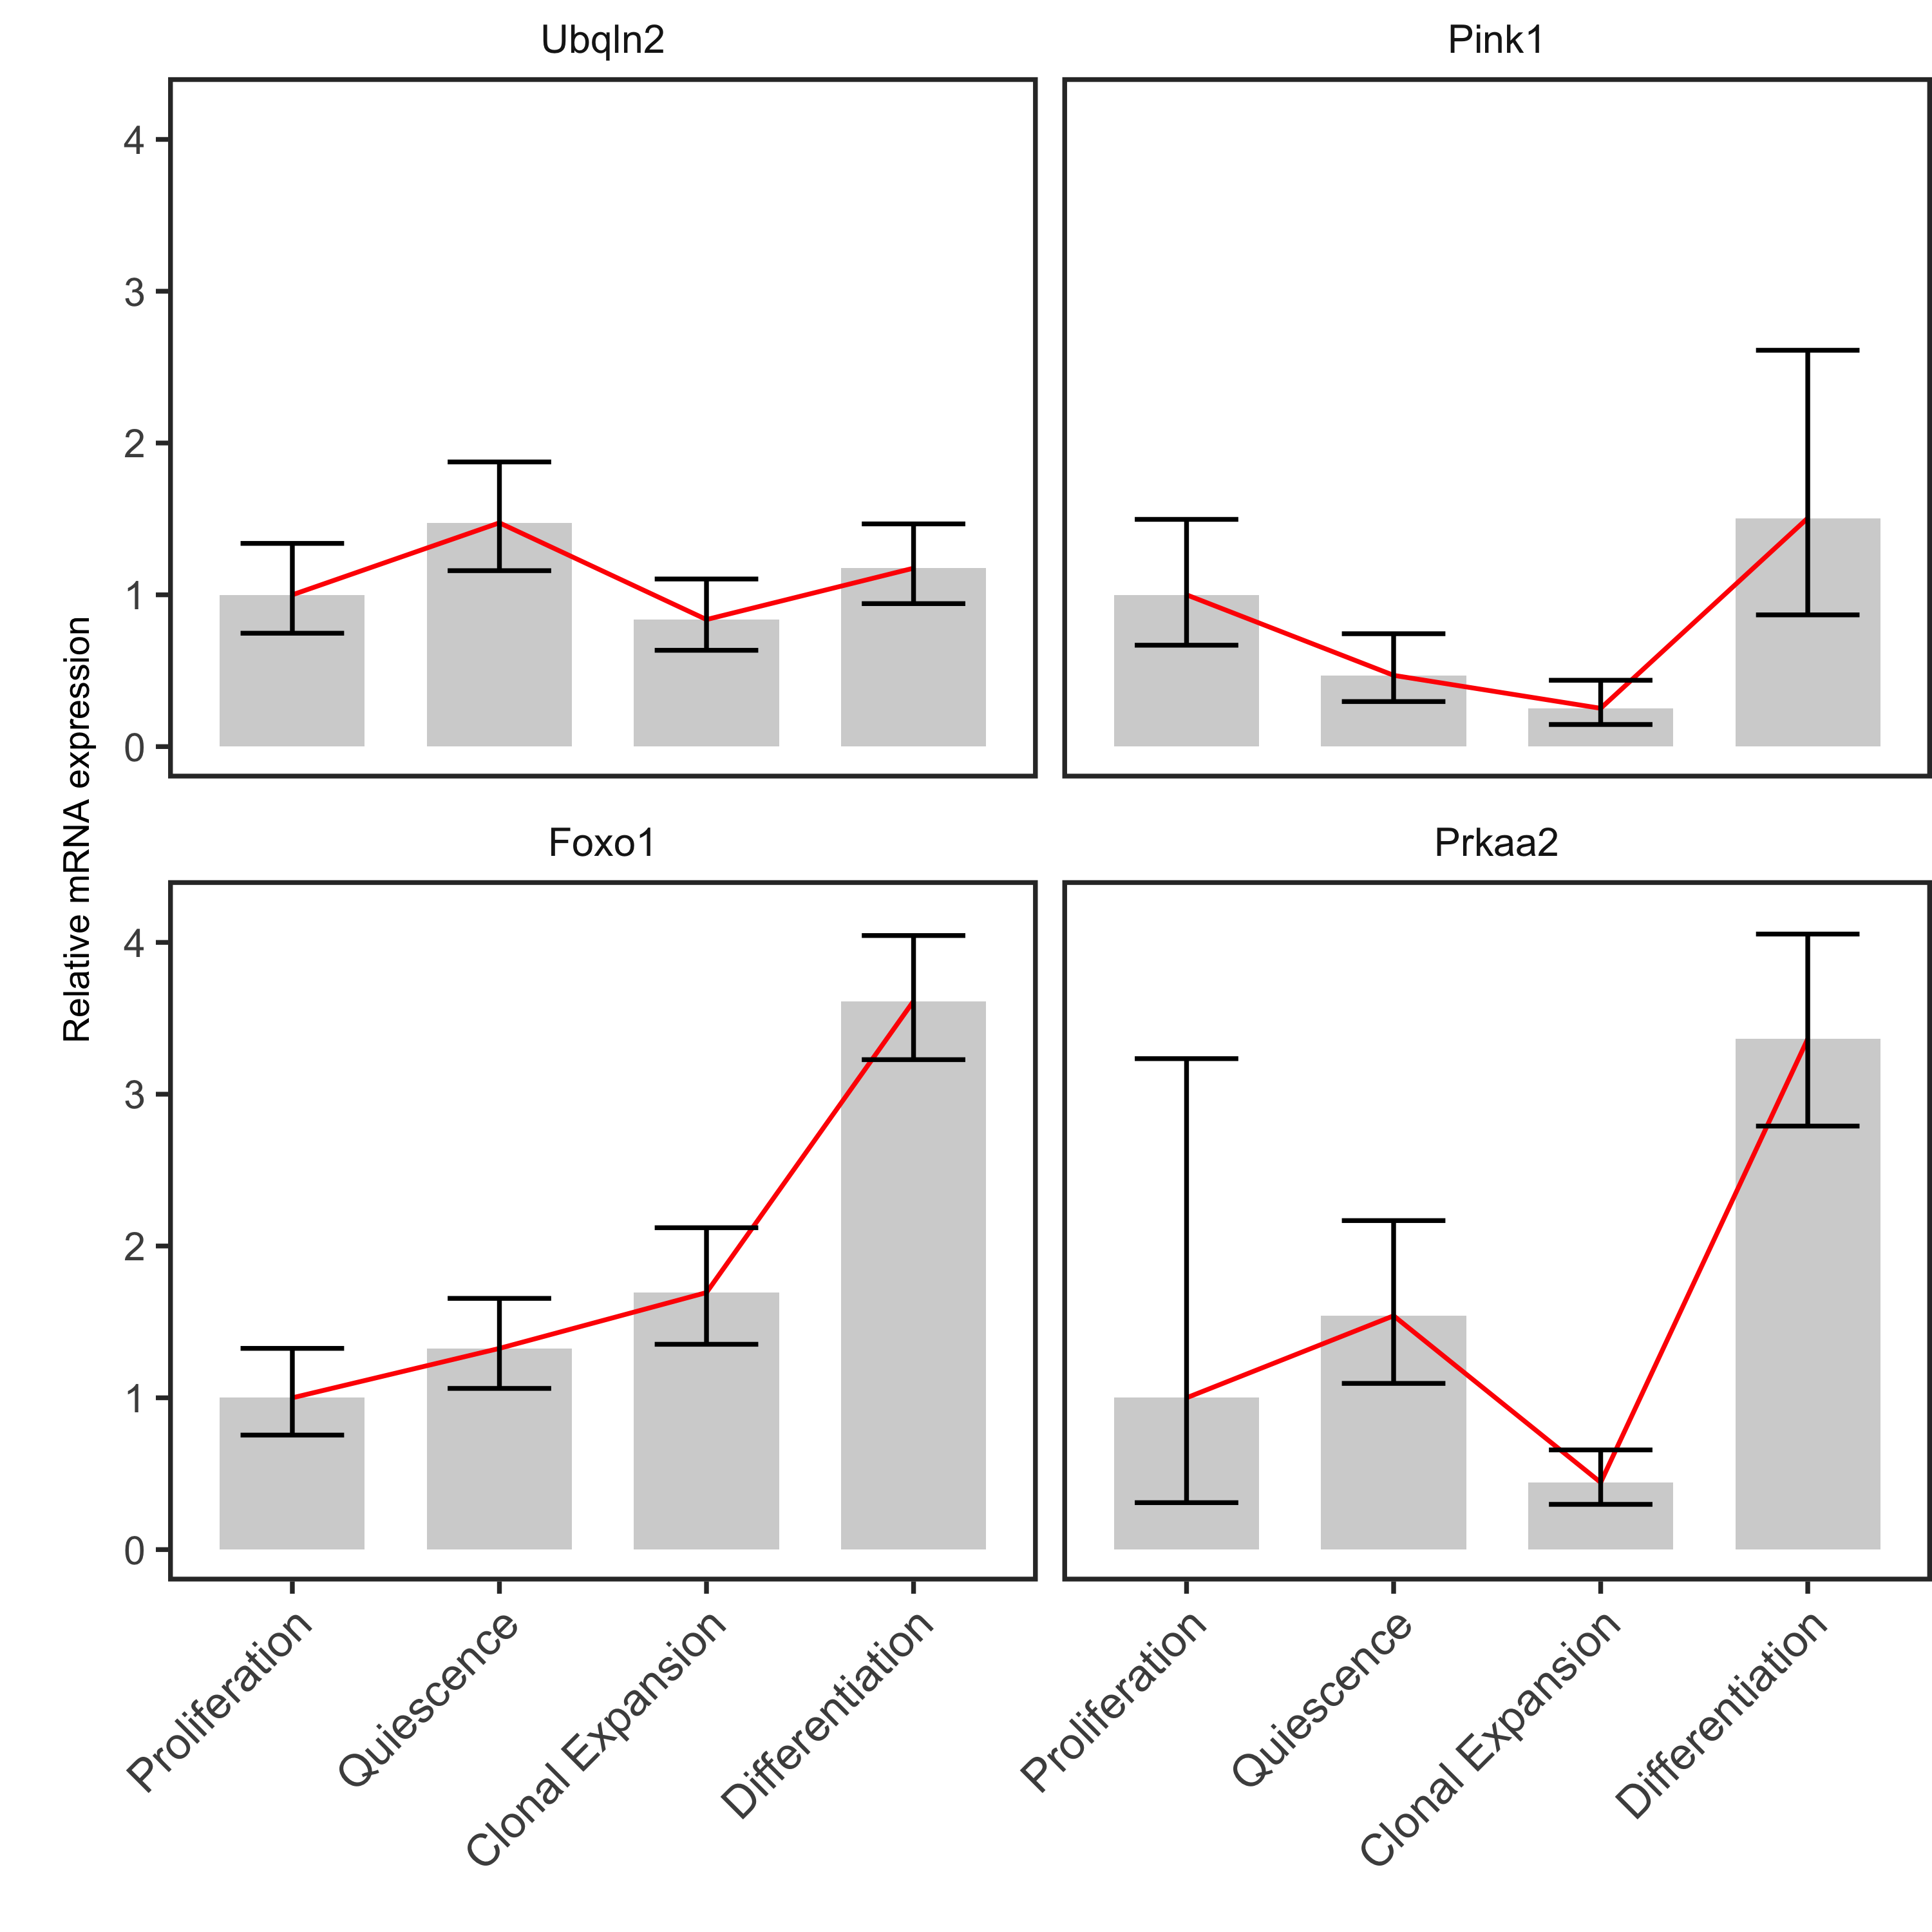
Figure 4
A
B
Proliferation
Quiescence
Clonal Expansion
Differentiation

Slide 10
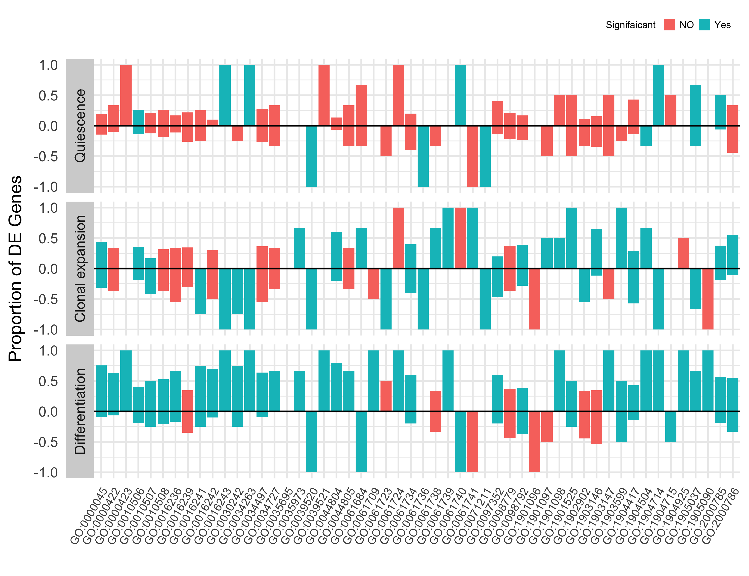
Figure 5

Slide 11
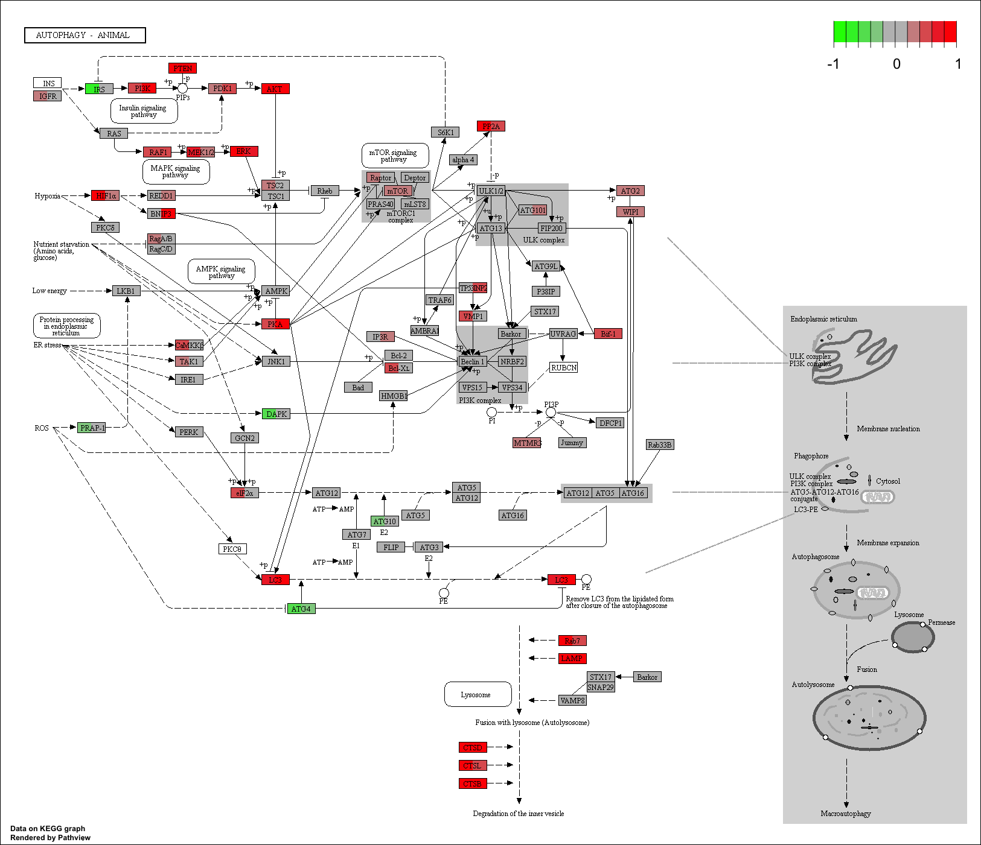
Figure 6

Slide 12
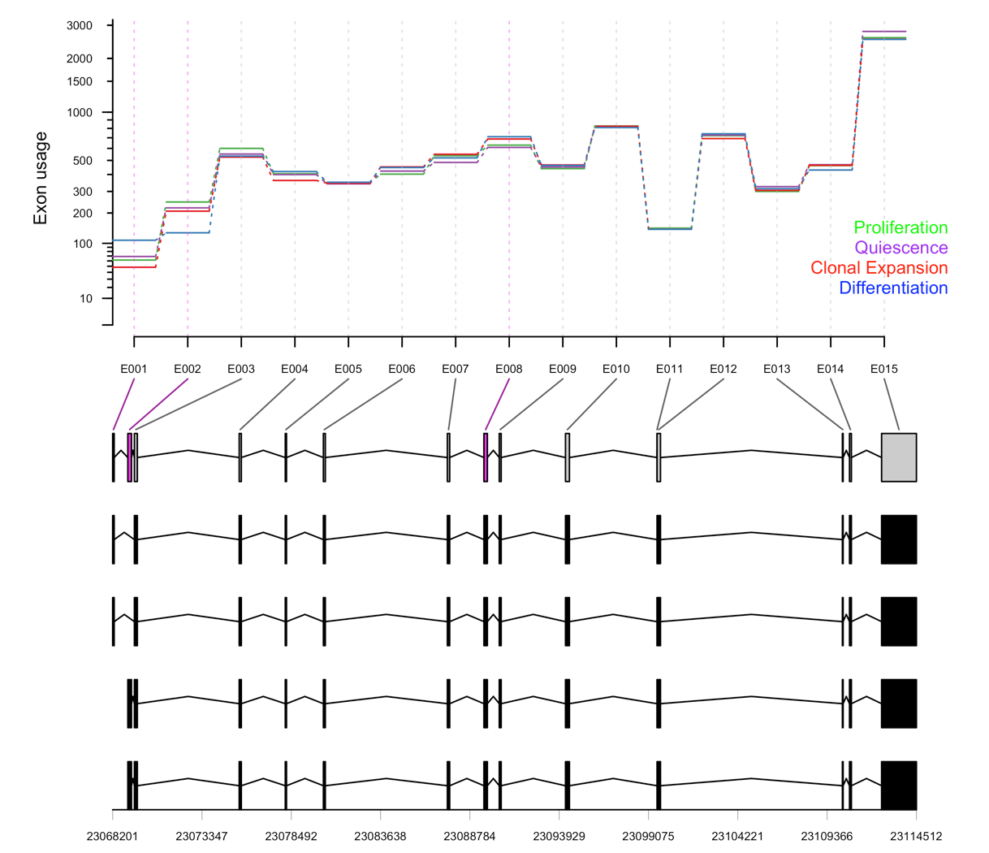
Figure 7

